Slide 1
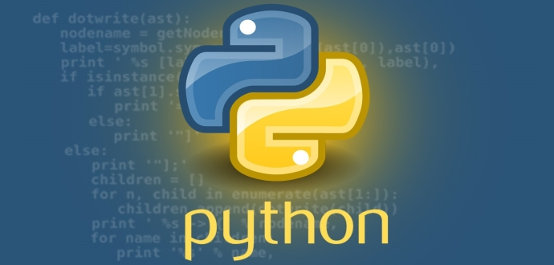
Python
src: https://www.techworm.net/wp-content/uploads/2017/04/lozingle_10032014.jpg

Slide 2

Python
❑ Interpreted high-level language for general-purpose programming
❑ Created by Guido van Rossum (1991)
Emphasizes code readability
Syntax that allows programmers to express concepts in fewer lines of code
Reference: http://whatis.techtarget.com/definition/data-driven-decision-management-DDDM
Src:https://upload.wikimedia.org/wikipedia/commons/thumb/6/66/Guido_van_Rossum_OSCON_2006.jpg/800px-Guido_van_Rossum_OSCON_2006.jpg

Slide 3
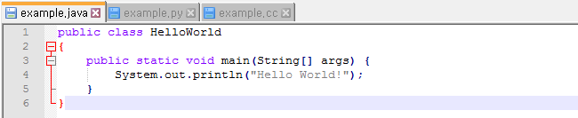
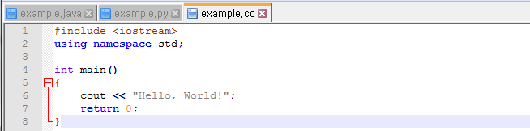
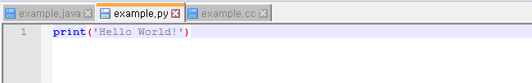
Python
❑ Printing out “Hello World”

Slide 4
Python for Data Analysis
❑ Python vs. R
Src: https://www.kdnuggets.com/2017/08/python-overtakes-r-leader-analytics-data-science.html

Slide 5
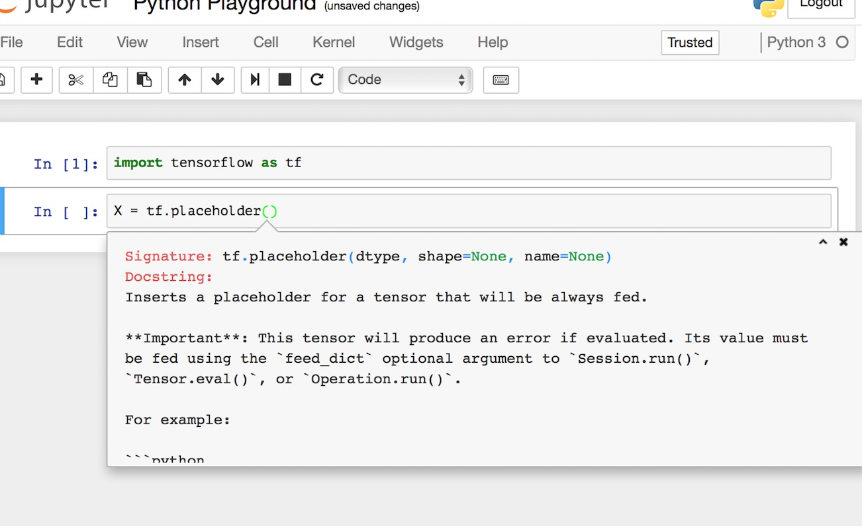
Python for Data Analysis
❑ Why Python?
Open source: free!
Useful Libraries and APIs
Vibrant, and growing community (Stackoverflow, Github, blogs, etc.)
Easy to program: quick coding & applications
Src: https://i.stack.imgur.com/5ZMt9.jpg

Slide 6
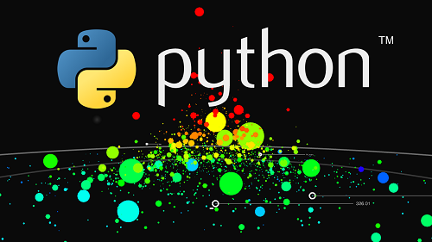
Python for Data Analysis
❑ What you can do with Python
Numerical Computation & Data Processing (NumPy, Pandas, BeautifulSoup, json, …)
Data Visualization (Networkx, Plotly, Matplotlib)
Statistical Analysis (Statsmodel, Scipy)
Machine Learning (Scikit-learn)
Deep Learning (Torch, Tensorflow, Keras, Theano, …)
Reinforcement Learning (OpenAI Gym)
Src: http://giftcourse.online/wp-content/uploads/2017/11/Data-Analysis-In-Python-Pandas-Business-Data-Science.png

